Slide 1
GBA C Programming

Slide 2
Quick Overview

Slide 3

Functional Diagram
Processor
Memory
Video
Controller
Video
Display
Button
Controller
Audio
Controller
DMA

Slide 4
Blanking Intervals

Slide 5
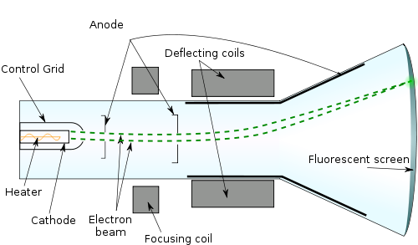
Cathode Ray Tube

Slide 6
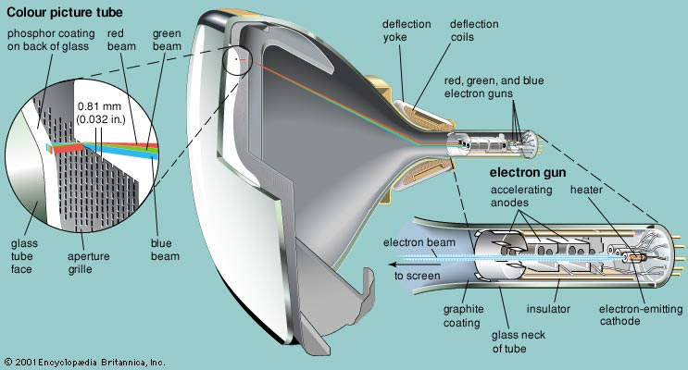
Color CRT
Note that in real life, the beams are not colored. Red, blue and green electrons are a myth. It’s the phosphors on the screen that glow in colors!

Slide 7
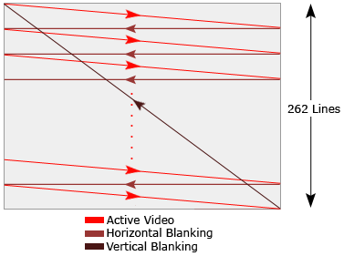
NTSC Scanning Pattern (interleaved)
http://belogic.com/uzebox/video_primer.htm

Slide 8
Blanking
GBA screen is refreshed at 60 Hz
There are pauses in the drawing process
For each scanline (160 lines)
Draw scanline (240 pixels)
Hblank (68 pixels)
Vblank (68 scanlines)
To avoid tearing, positional data is usually updated at the VBlank. This is why most games run at 60 or 30 fps.
FYI, this mimics the NTSC/PAL analog TV standards which required blanking intervals to reposition the electron beam.

Slide 9
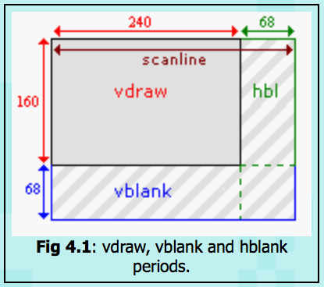
HBlank and VBlank

Slide 10
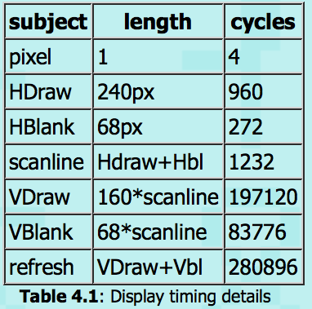
Drawing Times
A full screen refresh takes exactly 280896 cycles, divided by the clock speed gives a frame rate of 59.73.
From the Draw/Blank periods given above you can see that there are 4 cycles per pixel, and 1232 cycles per scanline.

Slide 11
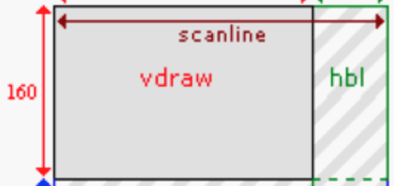

Video
Controller
Video
Display
videoBuffer
2
during vdraw: perform other useful computations
1
during vblank: make changes to the videoBuffer
Time ->
Video
Controller
Video
Display
videoBuffer
2
during vdraw: perform other useful computations
1
during vblank: make changes to the videoBuffer
Video
Controller
Video
Display
videoBuffer
2
during vdraw: perform other useful computations
1
during vblank: make changes to the videoBuffer

Slide 12
Processing Pipeline
Video
Controller
Video
Display
videoBuffer
2
during vdraw: perform other useful computations
1
during vblank: make changes to the videoBuffer
1
during vblank: make changes to the videoBuffer
balls[], oldballs[] and other data
drawRect()
Video
Controller
Video
Display
videoBuffer
Memory
2
during vdraw: perform (lots of) other useful computations

Slide 13
Question
How many scan line times are available during the vertical blanking interval on the GBA?
60
64
68
72
160
10

Slide 14
Button Input

Slide 15
Input
10 buttons (bit 0 through bit 9 of button register)s
A
B
Start
Select
Right
Left
Up
Down
Right shoulder
Left shoulder

Slide 16
Input
One button register
1 bit per button
0 pressed
1 not pressed

Slide 17
Definitions
#define BUTTONS *(volatile
unsigned int *)0x4000130
#define KEY_DOWN_NOW(key)
(~(BUTTONS) & key)

Slide 18
Question
The positions of the GBA’s ten buttons can be discovered programmatically by
Executing a special I/O instruction
Reading from a device register
Reading a word from memory
Loading the button register into a general purpose register

Slide 19
Multiple Code Files

Slide 20
Conventions
Files ending in .h
Declarations (no storage allocation)
Macros (#define)
Function prototypes
Can only #include other .h files
Files ending in .c
Definitions (allocation of storage)
Functions
Can only #include .h files
.c files are never included by anyone else

Slide 21
Configuration
// Library file
#include "Header.h"
int blah = 42;
void whee()
{
// Code
}
// Program files
// Program files
// Program files
// Program files
#include "Header.h"
int main()
{
whee();
...
// Header.h
typedefs
#defines
extern int blah;
void whee();

Slide 22
Example
video.c contains
reusable video functions
Variable definitions e.g.
unsigned short *videoBuffer =
(unsigned short *)0x6000000;
#include video.h

Slide 23
Example
video.h contains
typedefs
#defines
extern unsigned short *videoBuffer;
prototypes for functions found in video.c

Slide 24
Example
All program files containing functions that use any of the functions in video.c should include video.h; video.c should be included in the project makefile

Slide 25
DMA

Slide 26
What is DMA?
DMA = Direct Memory Access
Hardware supported data copy
Up to 10x as fast as array copies
You set it up, the CPU is halted, data is transferred, and CPU gains back control
Careful—reckless use can block interrupts

Slide 27
DMA Channels
Channel 0
Highest Priority
Time Critical Operations
Only works with IWRAM
Channel 1 & 2
Transfer sound chunks to sound buffer
Channel 3
Lowest Priority
General purpose copies, like loading tiles or bitmaps into memory

Slide 28
Using DMA
Source
REG_DMAxSAD (x = 0, 1, 2, 3)
The location of the data that will be copied
Destination
REG_DMAxDAD
Where to copy the data to
Amount
REG_DMAxCNT (DMA control)
How much to copy

Slide 29
REG_DMAxCNT
Lower 16 bits contain amount to transfer
Upper 16 bits contain other options
Turn on a DMA channel
When to perform the DMA
How the copy source and destination behave
How much to copy at a time
Whether or not to throw an interrupt on completion
Repeat or don't repeat on finish
Can be treated as one 32 bit register, or two 16 bit registers

Slide 30
REG_DMAxCNT
bits name define description
0-15 N Number of transfers.
21-22 DA DMA_DST_INC 00: increment after each transfer
(default)
DMA_DST_DEC 01: decrement after each transfer
DMA_DST_FIXED 10: none; address is fixed
DMA_DST_RESET 11: haven't used it yet, but
apparently this will increment
the destination during the
transfer, and reset it to the
original value when it's done.
23-24 SA DMA_SRC_INC
DMA_SRC_DEC
DMA_SRC_FIXED
Source Adjustment. Works just like the two bits
for the destination. Note that there is no
DMA_SRC_RESET; code 3 for source is forbidden.
25 R DMA_REPEAT Repeats the copy at each VBlank or
HBlank if the DMA timing has been set to
those modes.

Slide 31
REG_DMAxCNT
bits name define description
26 CS DMA_16,
DMA_32 Chunk Size.
Sets DMA to copy by halfword (if clear) or word (if set).
28-29 TM DMA_NOW 00: start immediately
DMA_AT_VBLANK 01: start at VBlank
DMA_AT_HBLANK 10: start at HBlank.
DMA_AT_REFRESH 11: Never used it so far, but here's how
I gather it works. For DMA1 and DMA2 it'll refill the
FIFO when it has been emptied. Count and size are forced
to 1 and 32bit, respectively. For DMA3 it will start the
copy at the start of each rendering line, but with a 2
scanline delay.
Timing Mode. Specifies when the transfer should start.
30 I DMA_IRQ Interrupt request. Raise an interrupt when
finished.
31 En DMA_ON Enable the DMA transfer for this channel.

Slide 32
Source Adjustment
REG_DMAxCNT bits 23-24
Incrementing source (default: 00₂) causes DMA to behave as a memory copy
Fixing source (10₂) causes DMA to behave as a memory fill
Copy the same thing over and over to a stretch of memory
Fill the screen with a color, clear a tilemap to all zeros, etc
Careful! SAD takes an address, not a value!
Make local variables volatile if using their address for a DMA fill

Slide 33
DMA Setup
We map a struct array over the DMA registers
typedef struct {
const volatile void *src;
void *dst;
u32 cnt;
} DMA_CONTROLLER;
#define DMA((volatile DMA_CONTROLLER *)
0x040000b0)

Slide 34
DMA Setup (cont)
#define DMA_TRANSFER(_dst,_src,_count,_ch,_mode) \
do { \
DMA[_ch].cnt = 0; \
DMA[_ch].src = (const void*)(_src); \
DMA[_ch].dst = (void*)(_dst); \
DMA[_ch].cnt = (_count) | (_mode); \
} while(0)
void dma_memcpy(void *dst, const void *src, u16 count)
{
DMA[3].cnt = 0; // shut off previous transfer
DMA[3].src = src;
DMA[3].dst = dst;
DMA[3].cnt = count | DMA_32| DMA_ON;
}

Slide 35
DMA Timing
Clearing a DMA register before its scheduled copy occurs will stop it from ever happening
Careful when using delayed DMA
Even immediate DMA has a 2 cycle delay
DMA calls in immediate succession could cancel the earlier one
2 cycles is short enough that returning from the DMA setup function allows the copy to begin before other code executes

Slide 36
Question
How many bytes are occupied by a GBA DMA channel’s device registers?
typedef struct {
const volatile void *src; //4
void *dst; //4
u32 cnt; //4
} DMA_CONTROLLER;
6
8
12
16
20

Slide 37
Filling a Rectangle

Slide 38
Why is DMA so Fast

Slide 39
Questions?

Slide 40
Loop Template
Initialize
While true
Previous state = Current state
Check buttons
Calculate new values for Current state
Wait for Vblank
Undraw using Previous state
Draw using Current state

Slide 41
Loop Template
Set Gamestate to INITPLAY
While true
Previous state = Current state
if Gamestate == PLAY
Check buttons
Calculate new values for Current state
Else if Gamestate == INITPLAY
Initialize the Current state
Wait for Vblank
If Gamestate == PLAY
Undraw using Previous state
Draw using Current state
Else if Gamestate == INITPLAY
Gamestate = PLAY

Slide 42
Text

Slide 43
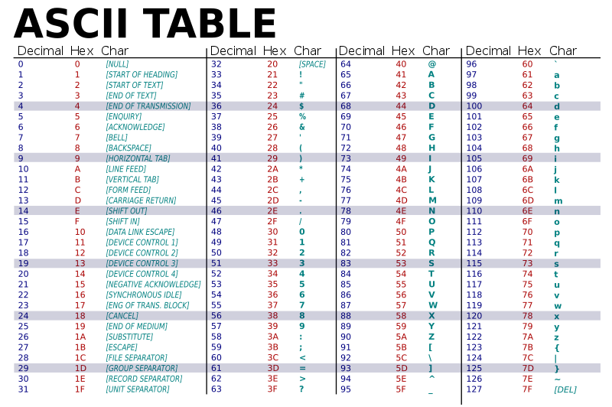
ASCII Table

Slide 44
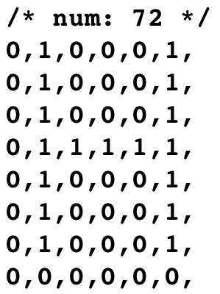
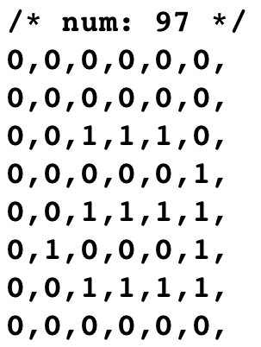
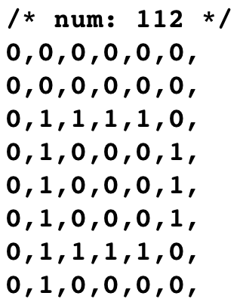
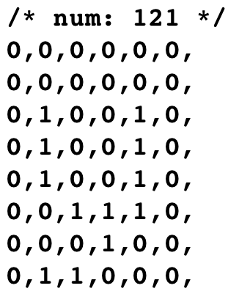
fontdata_6x8[]

